Slide 1
An empirical study on Perception of Correlation using Scatter Plots
Created by:-
Varshita Sher

Slide 2
Introduction
Limited knowledge regarding metrics underlying the perception of SCPs.
Need to assess the presence of significant difference between subjective and objective correlation values w.r.t to different
  Correlation indices
  Data distribution
  Symmetry of data enclosure
  Density (no. of data points used to plot SCP)
Discuss the presence of any single linear or non-linear regression pattern or mathematical model to which the human perception conforms.
Notes:
Subjective – user’s opinion
Objective – calculated using Mathematical formula

Slide 3
Aim
To study whether the “accuracy” and “precision” are systematically linked via Weber’s law where former refers to the ability of the user to guess the correlation simply by looking at the SCP and latter refers to the ability of the user to detect a presence of a difference in correlation coefficient of the two scatter plots.
Falsify the claims of a previous journal paper which states the applicability of Weber’s law to model the relation between human perception of correlation coefficient and mathematical formula calculated correlation value.
To study whether the JND (Just Noticeable Difference) is dependent on the reference correlation (positive or negative) chosen

Slide 4
Just Noticeable Difference
It is the quantity by which a given stimulus must increase or decrease before humans can reliably detect changes.
In simple terms the minimum amount of adjustment needed to produce a noticeable variation in sensory experience
For example, JND is be the minimum amount by which a person must raise his voice in order to be audible in a noisy room.
Ernst Weber was the first one to discover that this minimum amount is lawfully related to initial stimulus magnitude and coined the term, Weber’s law, as explained next.

Slide 5
Weber’s Law
Psychophysical law quantifying the perception of change in a given stimulus.
It states that the amount by which a physical stimulus must be increased in order for it to be detected by an observer is a constant fraction of the intensity of the original stimulus.
For example, in a quiet room it is easy to hear someone whisper but for a person to be audible in a noisy room he has to shout.
Hence, in context of JND:
ΔI = K I
where, K is the Weber’s fraction and I is the reference stimulus.

Slide 6
Tasks
Task JND: 2 adjacent SCPs with elliptical distribution, varying in respect to the correlation by an amount d.
Cases considered :- d= 0.05, 0.1, 0.15, 0.25, 0.3, 0.35
Task Weber: elliptical distribution of SCP where the change in correlation was brought about by varying the semi-minor axis (b).
Cases considered :- R = -0.9, -0.7, .. , 0, 0.1, 0.2, …, 0.9

Slide 7
Tasks
Task Density: vary the number of points used to plot a SCP for three reference correlation values i.e. R = 0.3, 0.7 and 0.9
R = 0.5

Slide 8
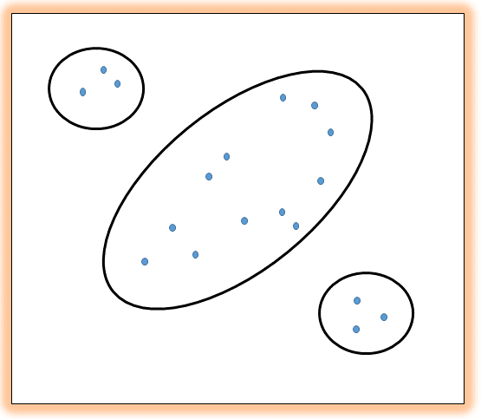
Tasks
Task Distribution: the data points are distributed such that there are several different clusters – one along 45 degree line and two along -45 degree line. These two act as outliers and test the user’s ability to correctly estimate the correlation.

Slide 9
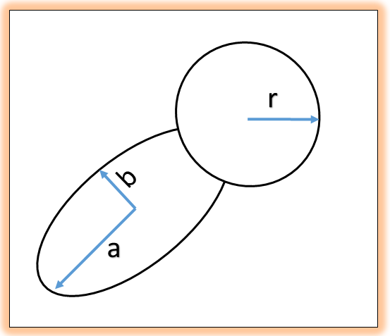
Tasks
Task Progressive Symmetry: change in variance of the variables at higher values. In this case we consider SCP where variance between data points increased at higher levels of first variable (x) and found that users chose to concentrate on majority of the x level where the data points were concentrated around the regression line and ignore higher dispersions at upper end of the x-axis.
R = 0.7

Slide 10
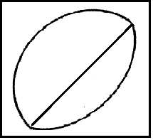
Tasks
Task Reflective Asymmetry: study the effect of varying the symmetry of points on either side of the 45 degree line.
R = 0.5

Slide 11
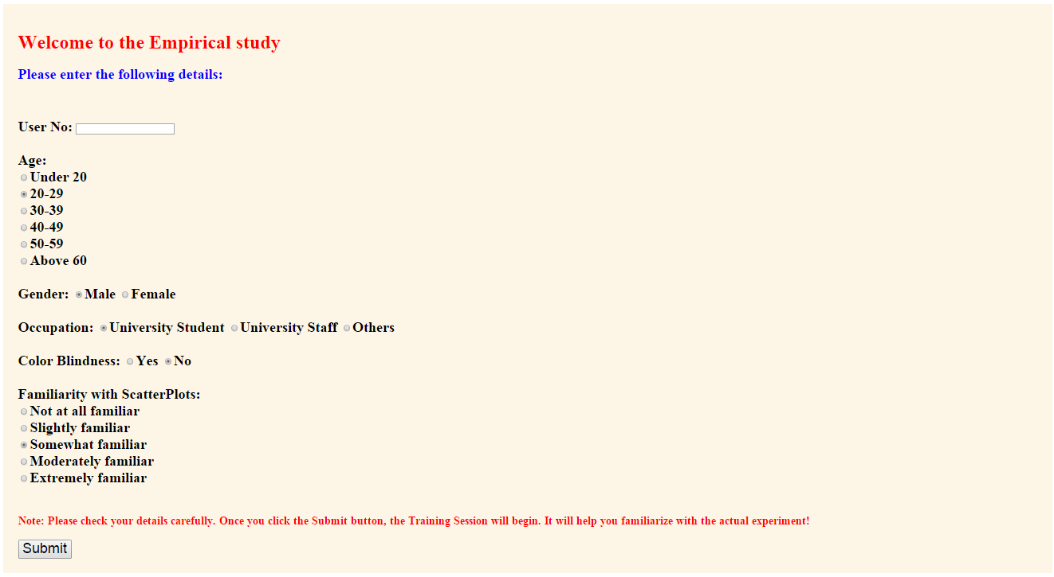
Software Implementation

Slide 12
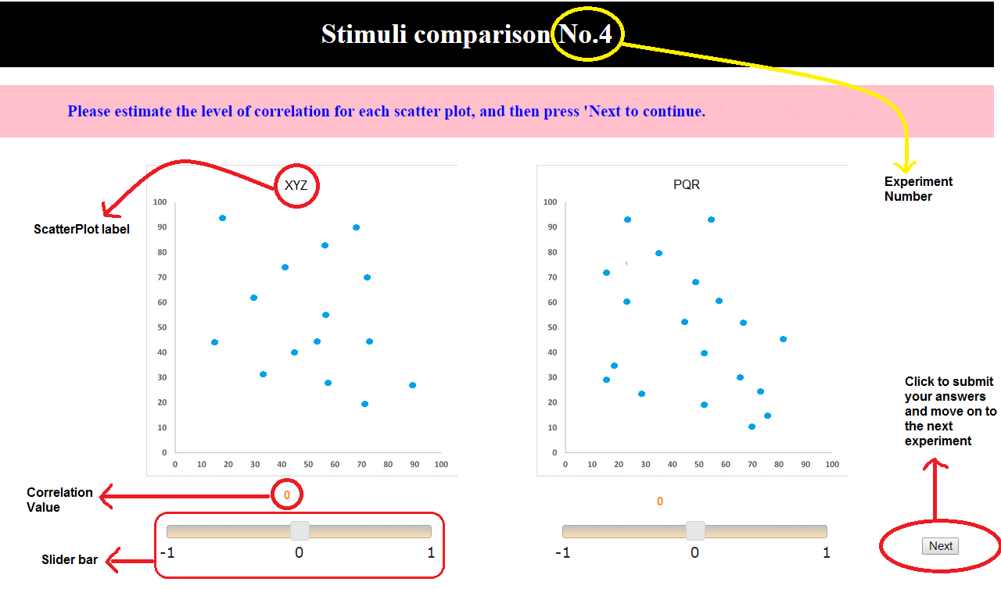
Software Implementation

Slide 13
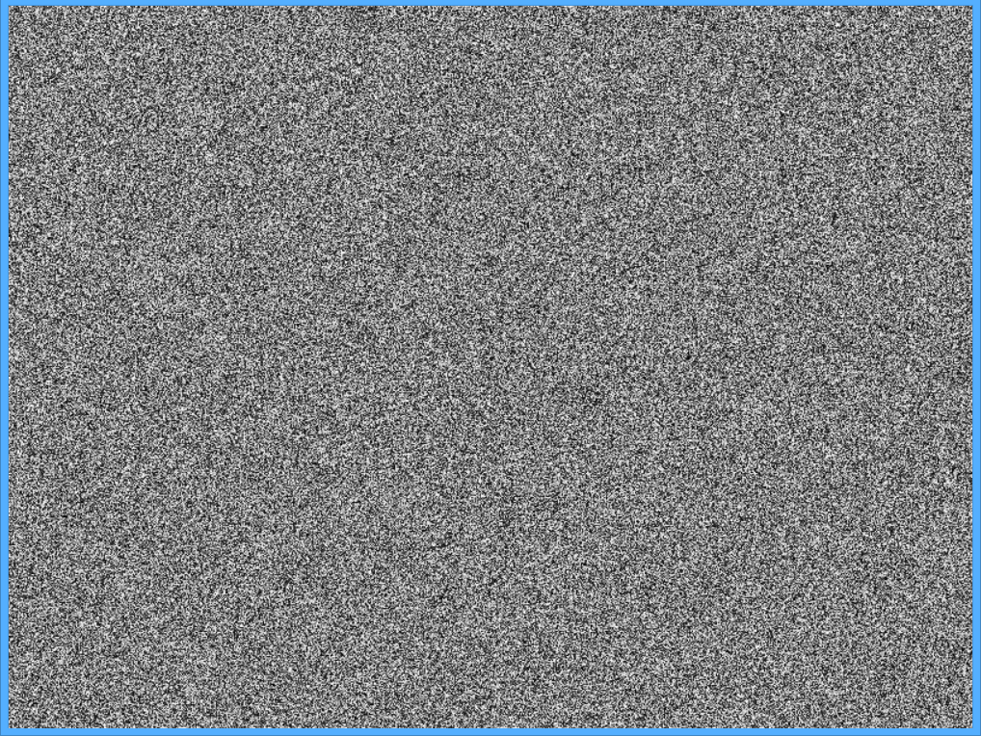
Software Implementation
Masking
Effect

Slide 14
Software Implementation
Deployed Agile Software Development process - “incremental model”
Written using JavaScript, HTML, PHP
Collects user response in form of subjective correlation values when presented with different SCPs in accordance with the principal of repeated measures.
Procedure:
  Pre-study presentation
  Collecting demographic information using radio buttons, text boxes and Likert scaling for familiarity ratings
  Training session providing feedback
  Testing session for the main trials
  Display 2 SCPs on the screen
  Use respective slider bars to record answers for each one
  Press ‘Next’ button to move onto next trial
  Timely break intervals to reduce fatigue and boredom
  Check points to monitor participant performance and detect random-clicks.
  Masking screen to relax the eye vision
  Amazon voucher as a thank-you token
  Feedback survey
Notes:
Each increment builds on the previous functionality, better handle changes from stakeholders. Short span for each increment.
Expose same set of participant to several measurement on diff times to eliminate errors (faulty handling of slider bar, misjudgment of correlation) and increase in statistical power

Slide 15
Back end processing done by software
The software calculates certain other metrics such as difference between objective and subjective correlation, amount of overestimation, underestimation, response time, etc.
It creates session variables for the demographic information entered by the user as they tend to remain constant for each individual.
The remaining information such as start time, stop time, estimated correlation, actual correlation (elements susceptible to change w.r.t individual trial) are stored as global variables.
A record is saved for each trial that consists of User ID, stimuli number, actual correlation, estimated correlation
2 ways to store user file
  a personalized .txt file is generated (by the user ID of the participant). After each trial, data is appended to it with a new line character between each record.
  a .json file is created as a backup copy. Using jStorage.set() data is stored on the web and accessed later on using jStorage.get().
Notes:
We stringify, all the participant’s data into a json variable which is then used as a parameter to create a blob object using Blob() constructor. A Blob object consists of the concatenation of the array of values given to it as parameter. We create a
URL to the json data using that blob which is then available for downloading by the user.

Slide 16
Falsifying Weber’s law
Estimated
Correlation
Ideal correlation curve
with weber fraction k
Estimated correlation
curve

Slide 17
Obtained curve
Ideal curve

Slide 18
Results
Used SPSS to perform hypothesis testing with significance level alpha= 0:05
Preliminary analysis – Friedman analysis to show presence of overall significance in data
Secondary analysis – Wilcoxon Signed-Rank test to detect source of significant difference
The human perception is affected by variation in data distribution, density and symmetricity, which means Weber’s law is insufficient to fit the human perception of “accuracy”
The “precision” also cannot be modelled as it was observed that the JND is dependent on the initial reference point chosen.
Task specific observations:
  The JND lies in the range 0.05 < JND < 0.10 irrespective of the reference point chosen.
  There isn’t a statistically significant difference between estimation of pos vs. neg correlations (elliptical configurations).
  As the distribution levels increases, the accuracy in user performance decreases
  Lower density values (such as 40) render biased results compared to 60, 80, 100 and 120. Also for each of them, error rate is max at higher R (R=0.7)
  Reflective Asymmetry has no impact on lower correlation values (R<=0.3) but affects depiction of higher correlation coefficients.
  Progressive Symmetry also leads to a decrease in accuracy of user judgment of correlation

Slide 19
Conclusions
As standalone quantities, the statistical indictor (Pearson or Spearman correlation coefficient) as well as the graphical indicator (SCPs) of correlation is insufficient and unreliable.
They must be considered as a ‘married couple’, complementing each other to depict necessary
We claim to disregard the common notion that ‘given a scatter plot, correlation can be easily perceived from it by anyone with just a little training.’

Slide 20
Thank you ☺

